Slide 1
APPLIED PHYSICS
(SEAP-113)

Slide 2
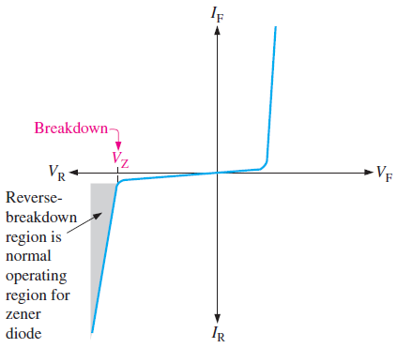
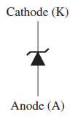
Zener Diode
Zener diode is a typical diode which is designed to operate in reverse-breakdown region

Slide 3
Zener Diode (contd.)
Two types of reverse breakdown in Zener diodes are observed i.e. avalanche and Zener
Avalanche breakdown occurs at higher voltage levels but Zener breakdown occurs at low voltages
Zener diode is heavily doped to reduce the breakdown voltage
An intense electric field is generated in depletion region
When applied voltage is near Zener breakdown voltage, the field is intense enough to pull the electrons from valence band to conduction band

Slide 4
Avalanche and Zener Effect
Avalanche effect is observed when the material is lightly doped
Zener effect is observed when material is heavily doped
Width of the depletion layer is depend on the amount of doping
Heavily doped diodes has narrow depletion layer and lightly doped diodes has wider depletion layer

Slide 5
Avalanche and Zener Effect (contd.)
In reverse bias, a small reverse current is observed due to minority carriers
When the applied voltage increases, it accelerate those minority carriers
Those minority carriers then collide with majority carriers and knock them out
This knocking out effect continues and hence current start to flow because of those majority carriers

Slide 6
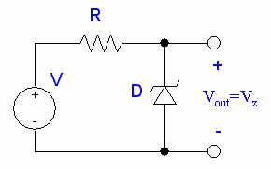
Zener Diode (contd.)
Main applications of Zener diode are voltage regulators
It can be used where a constant voltage is required (without fluctuations)

Slide 7
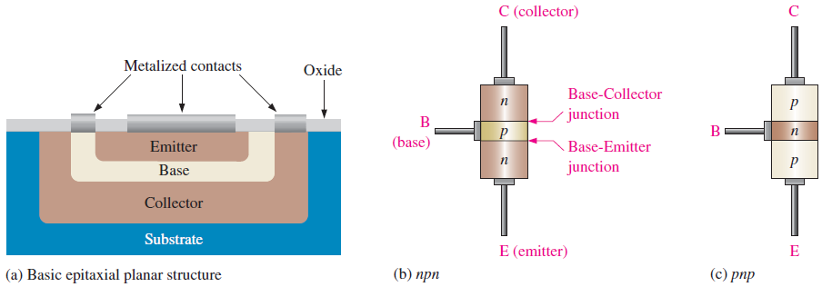
Bipolar Junction Transistors (BJT)
BJT is constructed when three different semiconductor regions are joined together
Three semiconductor regions are separated by two pn junctions
Three regions are called Emitter, Base and Collector

Slide 8
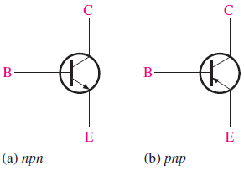
Bipolar Junction Transistors (contd.)
The pn junction joining the base region and the emitter region is called Base Emitter junction (Emitter Diode)
The pn junction joining the base region and collector region is called Base Collector junction (Collector Diode)
Base region is lightly doped and very thin
Emitter is heavily doped and collector is
moderately doped
BJT is Known as “Current-Controlled Device”.
Because Base current controls the output collector current.
Schematic symbol of BJT is shown in fig

Slide 9
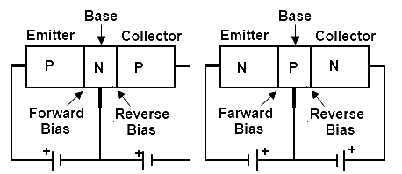
Bipolar Junction Transistors (contd.)
In normal configuration/operation Emitter diode is forward biased and Collector diode is reverse biased
Emitter has a job to emits its electrons so that they can inject in the base region
When emitter diode is forward biased, electrons can enter from emitter to base

Slide 10
Bipolar Junction Transistors (contd.)
Because of biasing, the electrons which enter in base has two options
To enter to the collector OR
To go out from the base
Majority of the electrons will enter the collector as base is lightly doped and very thin
Lightly doped means electrons have longer life in base and because of very thin base electrons have to move very short distance to enter into collector
E
B
C

Slide 11
Bipolar Junction Transistors (contd.)
When electrons enter into the collector, they feel a strong attraction because of the source voltage
Because of this electrons flow through the collector and reach to the positive terminal of the source
There are three useful configurations of transistors
Common Emitter
Common Base and
Common Collector

Slide 12
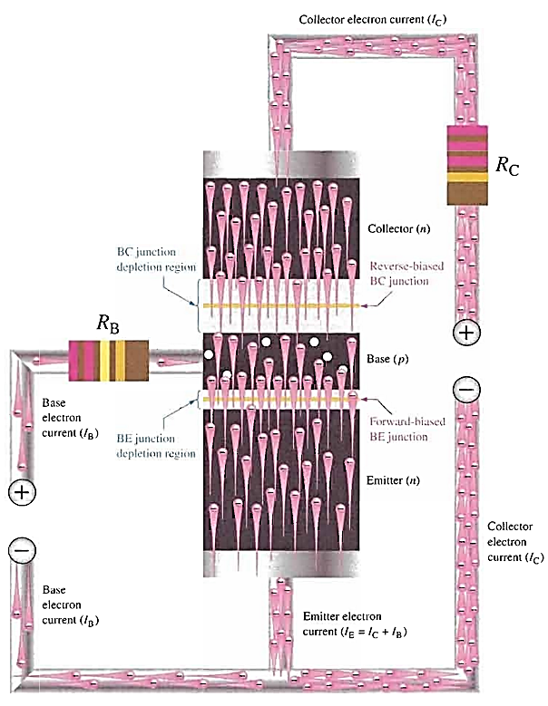
Bipolar Junction Transistors (contd.)

Slide 13
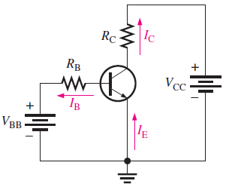
Common Emitter
In this type of configuration, ground side or common side of each voltage source is connected to the emitter
Hence it is called common emitter circuit/configuration
The circuit has two loops which are
Left loop is called the base loop and
Right loop is called the collector loop

Slide 14
Common Emitter (contd.)
In the base loop, the voltage source V_{BB} forward bias the emitter diode with R_{B} which is current limiting resistor
If we change the V_{BB} or R_{B}, it means we can change the current
Changing the base current will change the collector current it means base current will control the collector current

Slide 15
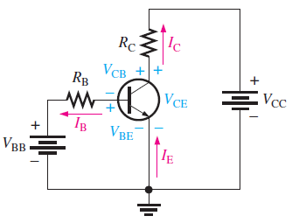
BJT Circuit Analysis
From the circuit diagram, three different dc currents and three dc voltages can be identified
DC currents are I_{B}, I_{E} and I_{C}
DC voltages are V_{BE}, V_{CB} and V_{CE}
When a transistor is in normal
operation then
$V_{BE}≅0.7V$

Slide 16
BJT Circuit Analysis (contd.)
By using Kirchof’s voltage law
$$V_{RB}=V_{BB}−V_{BE}$$
By Ohm’s Law
$$V_{RB}=I_{B}R_{B}$$
By substituting the values
$$I_{B}=\frac{V_{BB}−V_{BE}}{R_{B}}$$

Slide 17

BJT Circuit Analysis (contd.)
The voltage at collector can be calculated as:
$$V_{CE}=V_{CC}−V_{RC}$$
Drop across the collector resistor is
$$V_{RC}=I_{C}R_{C}$$
By substituting the values
$$V_{CE}=V_{CC}−I_{C}R_{C}$$
Where
$$I_{C}=β_{DC}I_{B}$$

Slide 18
Contd.
"Beta DC" or simply "Beta" (β) refers to the DC current gain of the transistor.
Beta is a key parameter that characterizes the relationship between the collector current (IC) and the base current (IB) in a BJT.
Beta provides information about how much the collector current is amplified concerning the base current. It's an important parameter in BJT amplifier design and analysis. A higher value of Beta indicates more significant current amplification, but the actual value can vary depending on the specific transistor and its operating conditions like temperature etc.

Slide 19
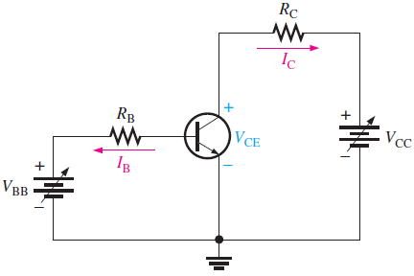
Collector Characteristic Curves
Collector characteristics curves shows us that how the collector current varies the collector to emitter voltage for specific values of base current
Assume that V_{BB} is producing a
certain values of I_{B} and V_{CC} is zero
Current is flowing only through base
loop and I_{C} is zero
As V_{CC} increases, V_{CE} increases and
collector currents increases

Slide 20
Collector Characteristic Curves (contd.)
This region is known as saturation region, I_{C} increases as V_{CC} increases because V_{CE} remains less then 0.7V
When V_{CE} exceeds 0.7V, the collector diode becomes reverse biased and transistor goes into active region or linear region
Ideally I_{C} remains constant as V_{CE} increases but I_{C} increases very slightly because of mobility of minority carriers
When V_{CE} is large enough, the reverse biased collector diode goes into the breakdown region and I_{C} increases rapidly
When I_{B} is zero, then transistor is in cutoff region

Slide 21
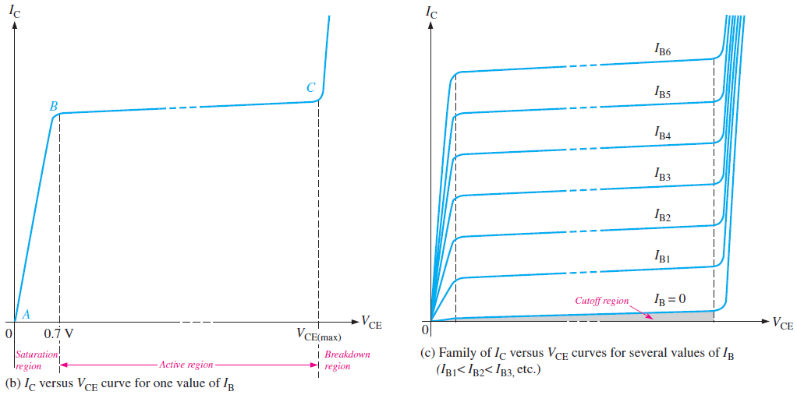
Collector Characteristic Curves (contd.)

Slide 22
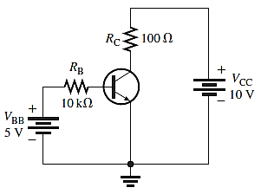
A simple Circuit Analysis
Calculate the value of I_{B}, I_{C}, I_{E}, V_{BE}, V_{CE} and V_{CB} for the circuit shown where 𝛽_{dc} = 150.

Slide 23
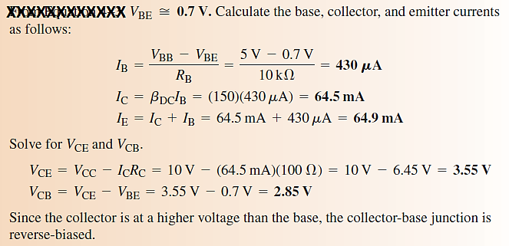
A simple Circuit Analysis (Solution)

